Slide 1
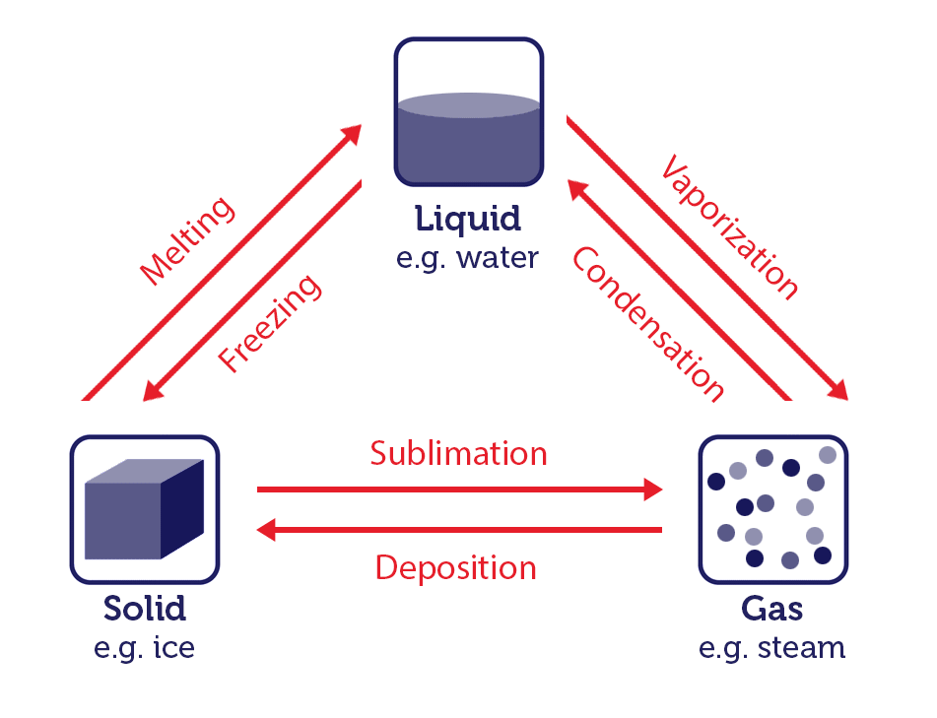
States of Matter and Intermolecular Forces

Slide 2
Learning Outcome
By the end of this section, students will be able to:
Explain the differences between the three states of matter based on the arrangement of the particles.
Describe the properties of gases, liquids and solids.
Explain how some objects can change their states as a result of a change in temperature.
Plot and interpret both Boyle’s and Charles’ law graphs.
Describe the arrangement of atoms and ions in crystalline structures.

Slide 3
States of Matter
The three states of matter are the three distinct physical forms that matter can take in most environments: gas, liquid and solid.
In extreme environments, other states may be present, such as plasma, Bose-Einstein condensates, neutron stars and quark-gluon plasmas.

Slide 4
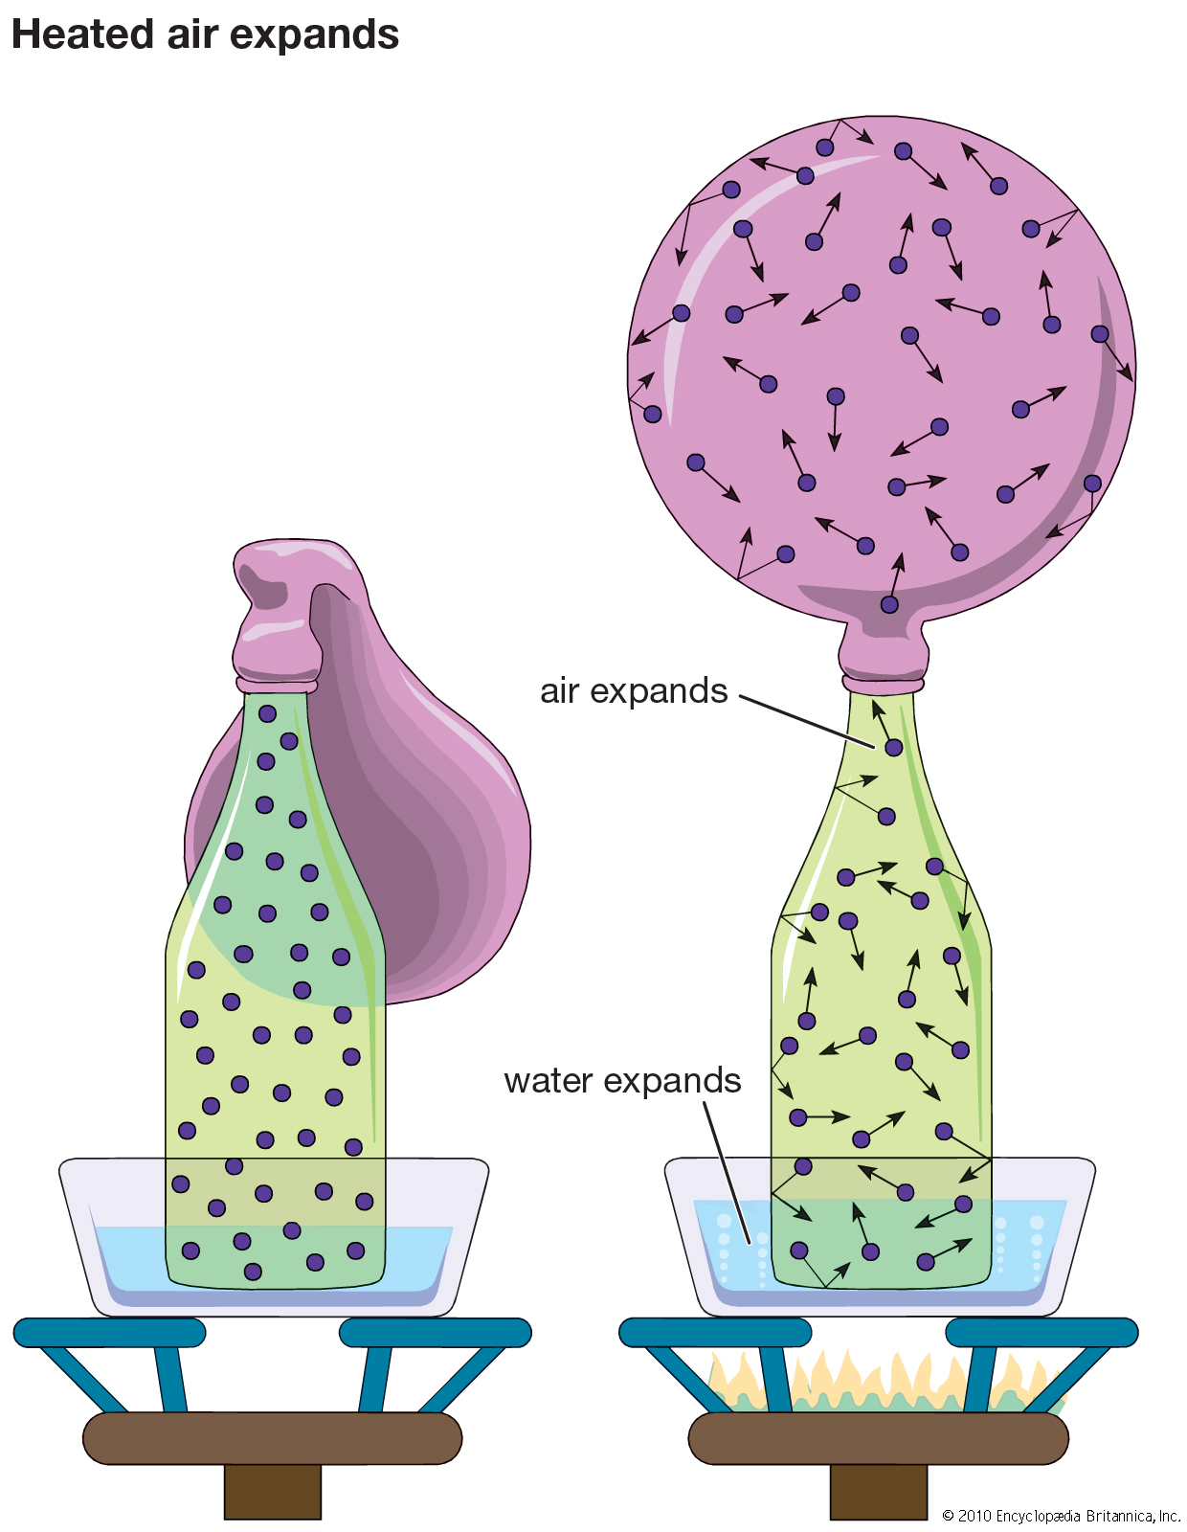
Nature of gases
Gases
can only be contained if fully surrounded by a container.
molecules have negligible intermolecular interactions and can move freely.

Slide 5
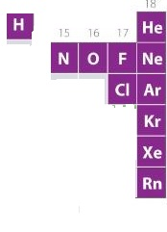
Nature of Gases
Eleven elements are gases under normal conditions (helium (He), neon (Ne), argon (Ar), krypton (Kr), xenon (Xe), and radon (Rn)
All substances that are gases at ordinary temperatures are molecular, except the six noble gases, which are monatomic (consist of single atoms).
Many compounds with low molar masses, such as CO₂, HCL, and organic compounds such as the methane, CH₄, of natural gas and the propane, C₃H₈, of camping fuel are gases at ordinary temperature.

Slide 6
Gases
The behaviour of gases can be predicted based on their properties below:
Pressure
Volume
Amount (moles)
Temperature
These properties of a gas sample emerge from the collective behaviour of vast numbers of its individual particles.

Slide 7
Gas Pressure
There is always an opposing force (F) arising from confined air.
The force, F, exerted by the gas divided by the area, A, on which the force is exerted gives the pressure (P) of the gas.
P = F/A
The SI unit of pressure is the Pascal, Pa
1 Pa = 1 kg.m⁻¹ s⁻²

Slide 8
Units of Pressure
Other units of pressure
1 bar = 10⁵ Pa
Weather charts commonly report pressures in millibars
1 mbar = 10⁻³ bar = 10² Pa
The standard pressure for reporting data is now defined as 1 bar exactly and denoted, P .

Slide 9
Units of Pressure
SI unit: pascal (Pa)
1 Pa = 1 kg·m⁻¹ ·s⁻² = 1 N·m⁻²
Conventional units
1 bar = 10⁵ Pa = 100 kPa
1 mbar = 10⁻³ bar = 10² Pa
1 atm = 1.01325 x 10⁵ Pa = 101.325 kPa
1 atm = 760 Torr
1 Torr (1 mmHg) = 133.322 Pa
1 atm = 14.7 lb·inch 2 (psi) *
*Derive the unit of pressure from the formular*

Slide 10
Question
The U.S. National Hurricane Center reported that the pressure of Hurricane Katrina (2005) fell as low as 902 mbar. What is that pressure in atmospheres?

Slide 11
Volume
Volume is the three-dimensional space inside the container holding the gas.
The SI unit of volume is the cubic meter, m³.
A more common and convenient unit is the liter, L.
1 liter = 1000 milliliters
1 cm³ - 1 mL
1000 cm³ = 1 L = 1 dm³

Slide 12
Amount (moles)
One mole of a substance contains approximately 6.022 x 10²³ particles of the substance. The particles may be atoms, molecules, ions or electrons. i.e.
One mole = 6.022 x 10²³ particles
1 mole of C atoms = 6.022 x 10²³ C atoms
2 moles of Na⁺ ion = 2 x 6.022 x 10²³ Na⁺ ion
3 moles of CO₂ molecules = 3 x 6.022 x 10²³ CO₂ molecules
Note: 6.022 x 10²³ mol⁻¹ = Avogadro's number

Slide 13
Temperature
The temperature of a gas is a measure of the average translational kinetic energy of the molecules.
When heated, gas molecules move faster;
the mass remains the same, but the kinetic energy, and hence the temperature, is greater because of the increased velocity of the molecules.

Slide 14
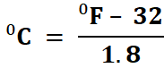
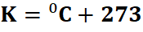
Temperature
The SI unit of temperature is Kelvin (K). However, Celsius or Fahrenheit scale is equally used.
The relation between Celsius, Fahrenheit and Kelvin:
⁰C

Slide 15
These factors that affect the behavior of gases are related and can be modeled using mathematical expressions. There are usually abbreviated as:
V = Volume of the gas (L)
T = Temperature (K)
P = Pressure (P)
n = amount (moles)

Slide 16
The Key Idea
The physical properties of any gas can be predicted by using the set of equations known as “the gas laws.”
The equations can be explained in terms of a model of a gas in which the molecules are in ceaseless random motion and so widely separated that they do not interact with one another except during brief collisions.

Slide 17
Gas Laws
Gas laws give the summaries of the properties of gases, particularly the variation of pressure with volume and temperature.
There are about six main laws associated with the behavior of gases. These include:
Boyle’s, Charles’, Avogadro’s and Gay Lussac’s laws; Combined gas law and Dalton’s law of partial pressure.

Slide 18
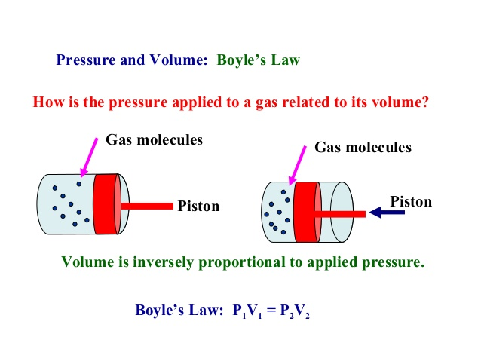
Boyle’s Law

Slide 19
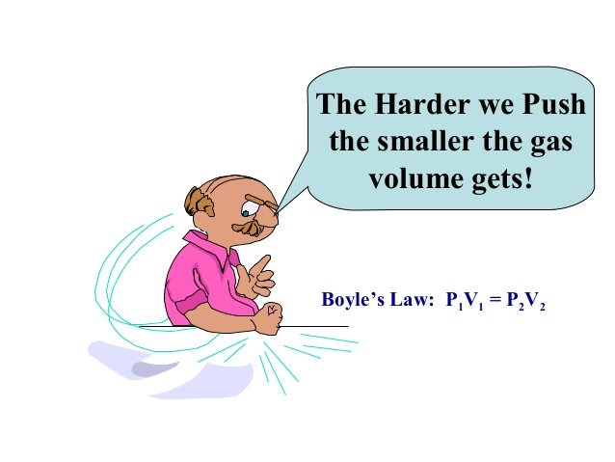
Boyle’s Law

Slide 20
Boyle’s Law
Boyle’s law: For a fixed amount of gas at constant temperature, volume is inversely proportional to pressure.

Slide 21
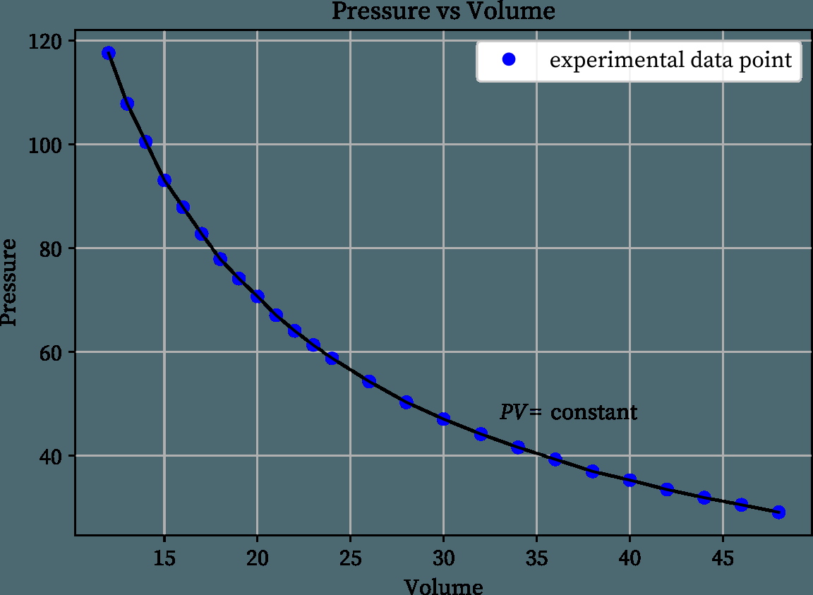
Boyle’s Law graph

Slide 22
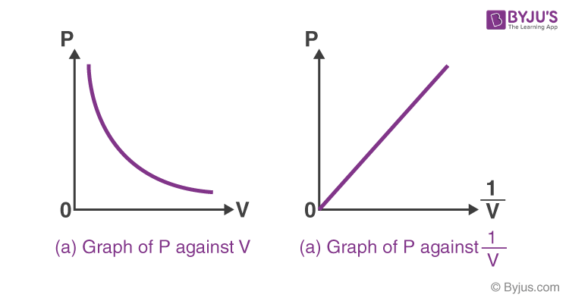
Boyle’s law graph
Note: When the pressure is plotted against 1/volume, a straight line is obtained. Boyle’s law breaks down at high pressures, and a straight line is not obtained in these regions (not shown).

Slide 23
How is Boyle’s law used in everyday life?
Answer: Boyle’s law can be observed in our everyday life.
Filling air in the bike tire is one of the significant applications of Boyle’s law. While pumping air into the tyre, the gas molecules inside the tire are compressed and packed closer together. It increases the pressure exerted on the walls of the tyre.

Slide 24
Question
A helium balloon has a volume of 735 mL at ground level. The balloon is transported to an elevation of 5 km, where the pressure is 0.8 atm. At this altitude, the gas occupies a volume of 1286 mL. Assuming that the temperature is constant, what was the ground level pressure?
Solution
Given
Initial Volume (V₁ ) = 735 mL
Final Pressure (P₂ ) = 0.8 atm
Final Volume (V₂ ) = 1286 mL
To Find: Initial Pressure (P₁ ) = ?
calculate the initial pressure of the gas using Boyle’s law.
P₁ V₁ = P₂ V₂
P ₁ X 735 = 0.8 X 1286
P₁ = 1028.8 / 735
P₁ = 1.39 ≈ 1.4 atm
Hence the ground level pressure is 1.4 atm.

Slide 25
Question
A fixed amount of gas occupies a volume of 1L and exerts a pressure of 400 kPa on the walls of its container. What would be the pressure exerted by the gas if it is completely transferred into a new container having a volume of 3 liters (assuming the temperature and quantity of gas remains constant)?
Given:
Initial volume (V₁) = 1L
Initial pressure (P₁) = 400 kPa
Final volume (V₂) = 3L
Boyle’s law, P₁V₁ = P₂V₂ ⇒ P₂ = (P₁V₁)/V₂
P₂ = (1L x 400 kPa)/3L = 133.33 kPa
Therefore, the gas exerts a pressure of 133.33 kPa on the walls of the 3-liter container.

Slide 26
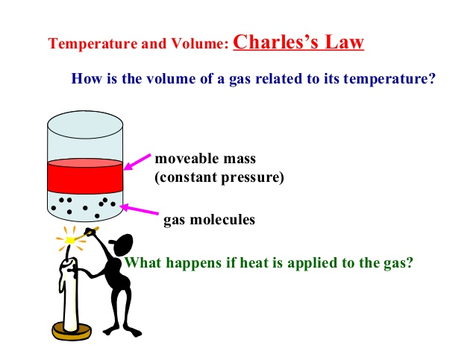
Charles’ Law

Slide 27
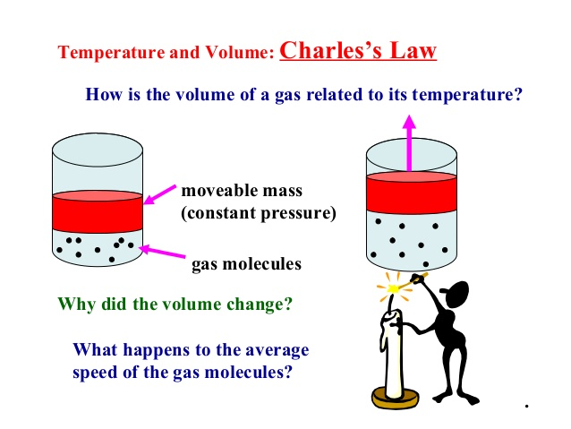
Charles’ Law

Slide 28
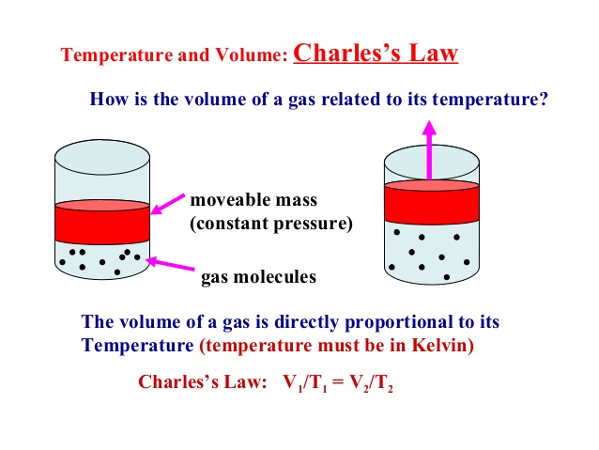
Charles’ Law

Slide 29
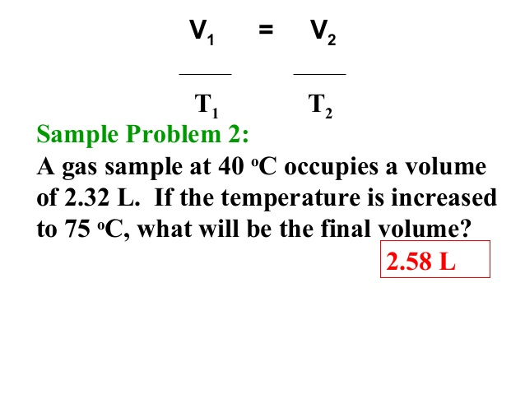
Charles’ Law

Slide 30
Question
.
A gas occupies a volume of 300cm3 at 0°C(degree celsius) and 780 torrs. What volume (in liters) will it occupy at 80°C (degree celsius) and 780 mm Hg?
Given,
V1= 300 cm³
T1= 0° C = 0+273 = 273 K
T2= 80° C = 80+273 = 353 K
V2 =?
Here the pressure is constant and only the temperature is modified.
Using Charles Law
(V1)/(T1)=(V2)/(T2)
300 / 273=V2 / 353
V2= 300 x 353
273
387cm3
1 milliliter = 0.001 litre =1 x 10⁻³ litre
∴ 387cubic centimeter = 387 x 10⁻³ litres = 0.387litres

Slide 31
Gay-Lussac’s Law
Explains the relationship between pressure, P and temperature, T at constant volume, V and number of moles, n.
If T is increased, the gas molecules will move faster, colliding with the walls more frequently & more energetically.
Pressure results from collisions between gas molecules and walls of container.
So, if T increases, we expect P to increase.

Slide 32
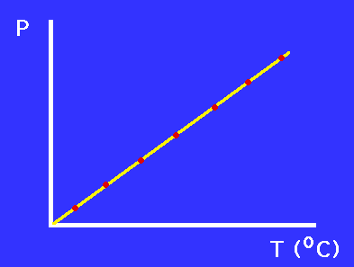
Typical data from a Gay-Lussac type experiment. What kind of relationship is illustrated in this graph?

Slide 33
Gay-Lussac’s Law
When volume is held constant, pressure of a gas is directly proportional to its temperature.
P₁ = P₂
T₁ T₂
P₁ = initial pressure
T₁ = absolute temperature.
P₂ = final pressure
T₂ = final temperature.

Slide 34
Combined Gas Law
The combined gas law describes how a gas responds to changes in conditions.
It combines the previous gas laws into a single equation.
It states that the ratio of the product of pressure, volume and the absolute temperature of a gas is equal to a constant.

Slide 35
Note
SATP (Standard ambient temperature and pressure) = 25⁰C (298.15 K) and 1 bar;
STP (standard temperature and pressure)
= 0⁰C (273.15 K) and 1 atm.

Slide 36
Question
When measured at STP, a quantity of gas has a volume of 500 dm³. What volume will it occupy at 0 ºC and 93.3 kPa?
(101.3 kPa) x (500 dm³) = (93.3 kPa) x (V₂)
273 K
273 K
(101.3) x (500) = (93.3) x (V₂)
P₁ = 101.3 kPa
T₁ = 273 K
V₁ = 500 dm³
P₂ = 93.3 kPa
T₂ = 0ºC + 273 = 273 K
V₂ = X dm³
V₂ = 542.9 dm³
= 542.9L
1 dm³ = 1L

Slide 37
Practice Questions
In an investigation of the properties of the coolant gas used in an air-conditioning system, a sample of volume 500 mL at 28.0⁰C was found to exert a pressure of 92.0 kPa. What pressure will the sample exert when it is compressed to 300 mL and cooled to -5.0⁰C?

Slide 38
Avogadro’s Law
Avogadro’s law states that under the same conditions of temperature and pressure, a given number of gas molecules occupy the same volume regardless of their chemical identity.
The properties of a gas can all be combined into a single expression relating pressure (P), volume (V), temperature (T) and amount (n) of a gas:
PV = constant x nT
When the constant of proportionality for the laws is written as R, this expression becomes the ideal gas law:
PV = nRT

Slide 39
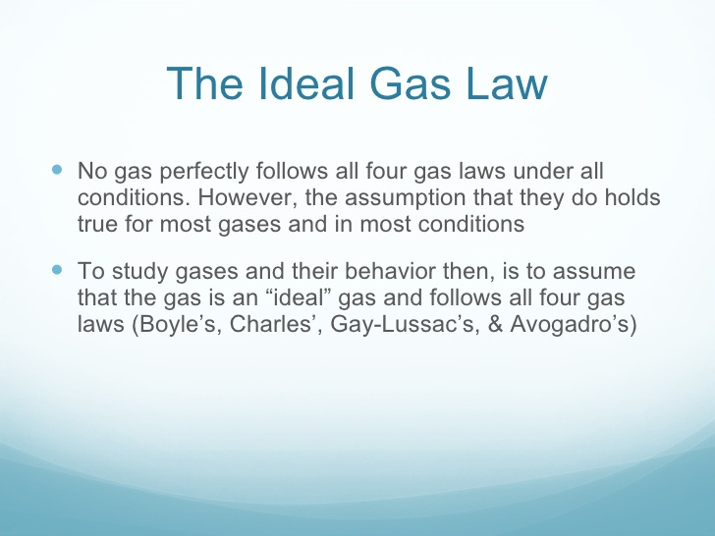

Slide 40
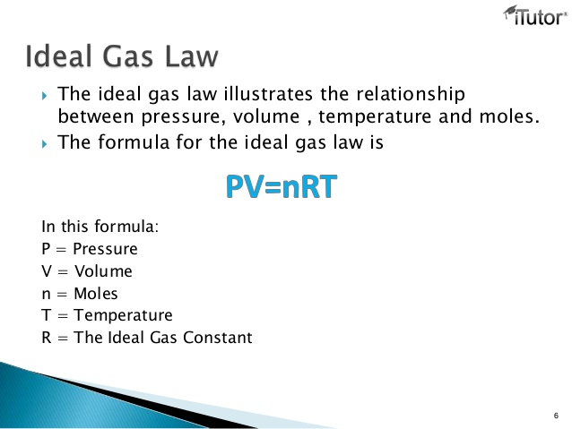

Slide 41
Assumptions of the Ideal Gas Law
The ideal gas law is based on a series of assumptions on gas particles:
All gas particles are in constant motion and collisions between the gas molecules and the walls of the container cause the pressure of the gas.
The particles are so small that their volume is negligible compared with the volume occupied by the gas.
The particles don't interact. There are no attractive or repulsive forces between them.
The average kinetic energy of the gas particles is proportional to temperature.
Note: Ideal gas does not really exist in the environment and is a hypothetical gas.

Slide 42
The Universal Constant (R)
R (the gas constant) has the same value for all gases.
Because R is independent of the identity of the gas, it is said to be a “universal constant.”
When SI units are used, (pressure in Pa, volume in m³, temperature in K, and amount in moles),
R is obtained in J.K⁻¹.mol⁻¹
R = 8.314 J.K⁻¹.mol⁻¹
Others: R = 8.206 X 10⁻² L·atm·K⁻¹.mol⁻¹
8.314 X 10⁻² L·bar·K⁻¹ ·mol⁻¹
8.314 L·kPa·K⁻¹ ·mol⁻¹
62.364 L·Torr·K⁻¹ ·mol⁻¹

Slide 43
Question
What mass of ammonia is required to fill a 14.88L bottle to a pressure of 199kPa at 25⁰C?

Slide 44
Real Gases
A real gas is defined as a gas that does not obey gas laws at all standard pressure and temperature conditions.
When the gas becomes massive and voluminous it deviates from its ideal behaviour.
Real gases have velocity, volume and mass. When they ‘re cooled to their boiling point, they liquefy.
When compared to the total volume of the gas the volume occupied by the gas is not negligible.

Slide 45
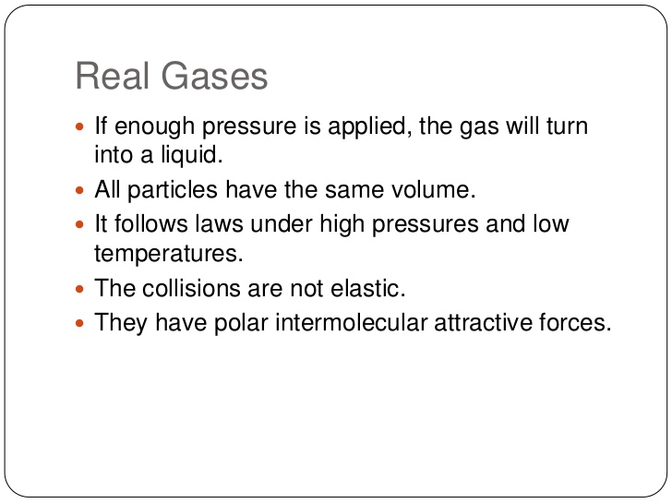

Slide 46
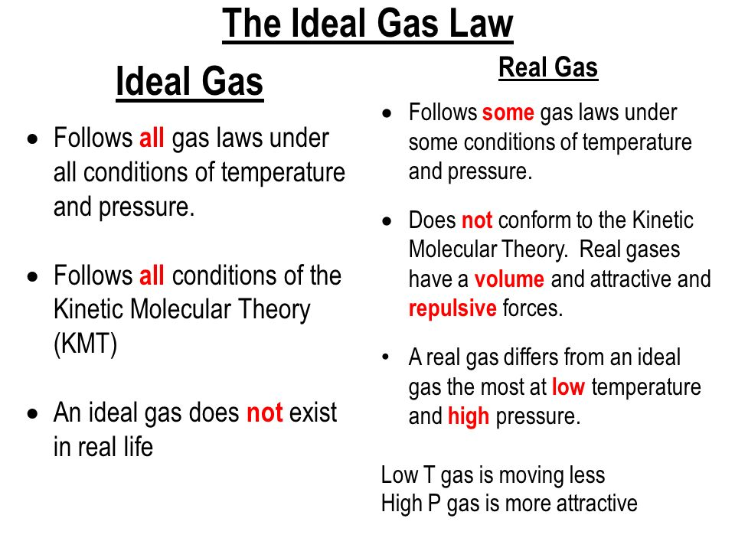

Slide 47
Gas Law Calculations
Boyle’s Law
PV = k
Charles’ Law
V
T
= k
P and V
change
n, R, T are
constant
Ideal
Gas Law
PV = nRT
T and V
change
P, n, R are
constant
P, V, and T change
n and R are constant
Combined
Gas Law
PV
T
= k

Slide 48
Dalton’s Law of Partial Pressure
John Dalton was the first to calculate the pressure of a mixture of gases.
Dalton summarized his observations in terms of the partial pressure of each gas, the pressure that the gas would exert if it occupied the container alone.
He described the behavior of gaseous mixtures by his law of partial pressures which states that
the total pressure of a mixture of gases is the sum of the partial pressures of its components.

Slide 49
Dalton’s Law of Partial Pressure
If the partial pressures of the gases A, B, . . .are denoted as P_{A}, P_{B}, . . . and the total pressure of the mixture as P, then Dalton’s law can be written as:
P = P_{A} + P_{B} + P_{C} + …..P_{n}
It is exactly true only for gases that behave ideally, but it is a good approximation for nearly all gases under normal conditions.

Slide 50
Dalton’s Law of Partial Pressure
The total pressure of a mixture of gases = the sum of the pressures of all the gases in the mixture.
The portion contributed by each gas is called the partial pressure of that gas.

Slide 51
Question
A mixture of O₂, CO₂, and N₂ has a total pressure of 1800 torr. The partial pressure of the O₂ is 380 torr and the partial pressure of the CO₂ is 960 torr. What is the partial pressure of the N₂?

Slide 52
Solution
P_{tot} = P₀₂ + P_{CO2} + P_{N2}
Rearrange: P_{N2} = P_{tot} – P_{O2} – P_{CO2}
P_{N2} = 1800 – 380 – 960 = 460 torr

Slide 53
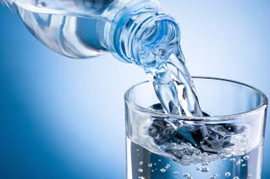
Liquids

Slide 54
Liquids
The condensed phases of matter (liquids and solids) result from attractive intermolecular forces.
The forces that hold molecules together are of crucial importance for determining the physical properties of bulk samples.
Atoms, ions and molecules form liquids when they have enough energy to move past their neighbors but not enough to escape from them entirely.

Slide 55
Liquids
Liquids flow and keep no definite shape because their molecules are loosely packed and constantly moving.
They take the shape of their container but maintain constant volume.
The atomic and molecular properties are related to the structure and properties of liquids.

Slide 56
Liquids
Scientists design new materials by considering how the properties and interactions of individual particles give rise to bulk properties.
Formulating the materials of tomorrow will require an understanding of these relationships.

Slide 57
Liquids
Molecules attract one another.
Without forces between molecules, our flesh would drip off our bones and the oceans would be gaseous in nature.
The forces between molecules govern the physical properties of bulk matter and help to account for the differences in the substances around us;
CO₂ is a gas we exhale.
Ice floats in water, etc.
Explain why ice floats in water.

Slide 58
Liquids
Individual water molecules, for instance, are not wet, but ‘bulk water’ is wet because water molecules are attracted to other substances and spread over their surfaces.
Rivers, lakes and oceans exist because water molecules attract one another and form liquid. Without that liquid, there would be no life.

Slide 59
Liquids
Molecules also repel one another.
When pressed together, molecules resist further compression.
As a result, we do not sink into the floor
solid objects have specific sizes and shapes.
Even in gases, repulsion is important as it means that molecules do not simply pass through one another but undergo actual collisions.

Slide 60
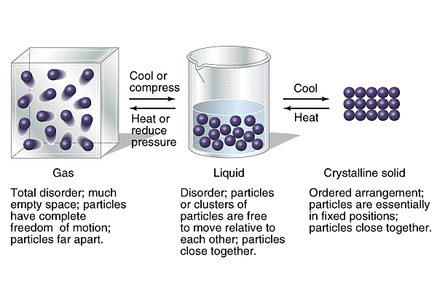
Liquids

Slide 61
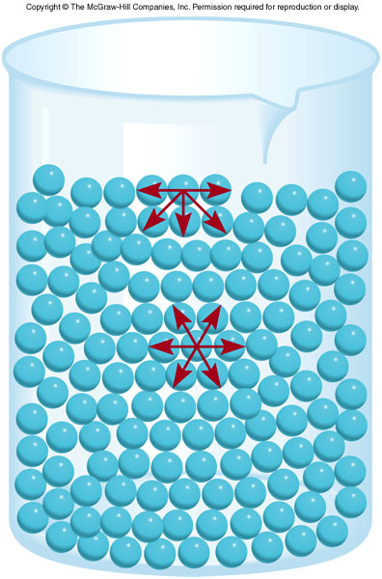
Major Properties of Liquids
Surface tension
the amount of energy required to stretch or increase the surface of a liquid by a unit area.
Strong intermolecular forces
High surface tension
Intermolecular attraction tend to pull molecules into liquids and cause the surface to tighten like a plastic film.

Slide 62
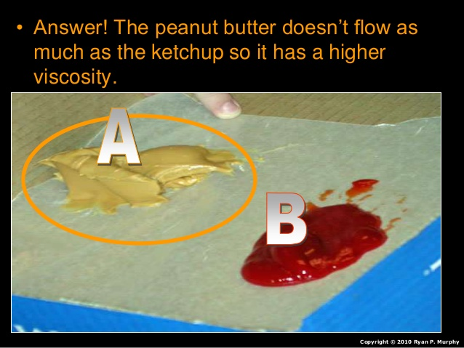
Properties of Liquids
Viscosity is a measure of a fluid’s resistance to flow.
Strong intermolecular forces
High viscosity

Slide 63
Intra- vs Inter-molecular Forces
Intramolecular forces are the forces that hold atoms together within a molecule. Intermolecular forces are forces that exist between molecules.
Intermolecular forces exist between molecules, as distinct from the forces responsible for the formation of chemical bonds between atoms.
Chemical bonds are the forces of attraction that tie atoms together;
formed when the electrons in the outermost electronic “shell” of an atom (valence electrons) interact.

Slide 64
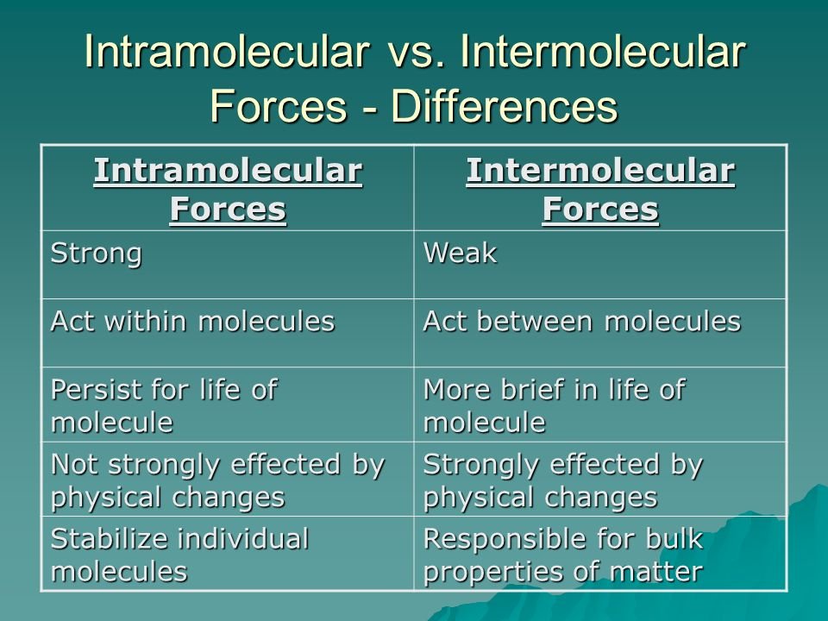
Intra- vs Inter-molecular Forces

Slide 65
Intermolecular Forces
The major difference between the 3 states of matter is the strength of the intermolecular forces of attraction.
Stronger forces bring molecules closer together. In gases, intramolecular forces play only a minor role since the molecules are far apart. But Solids and liquids are called the condensed phases since the molecules are close to each other.
With liquids and solids, the forces that hold molecules together are central to determining the physical properties of bulk samples.

Slide 66
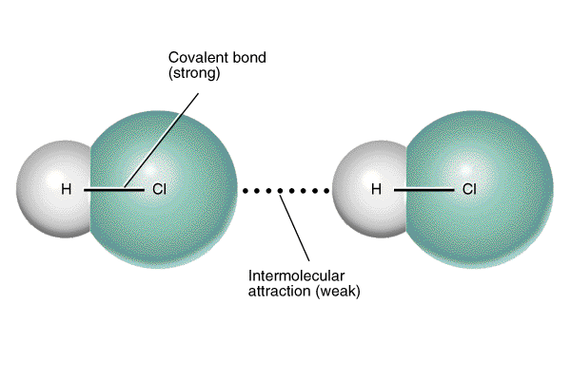
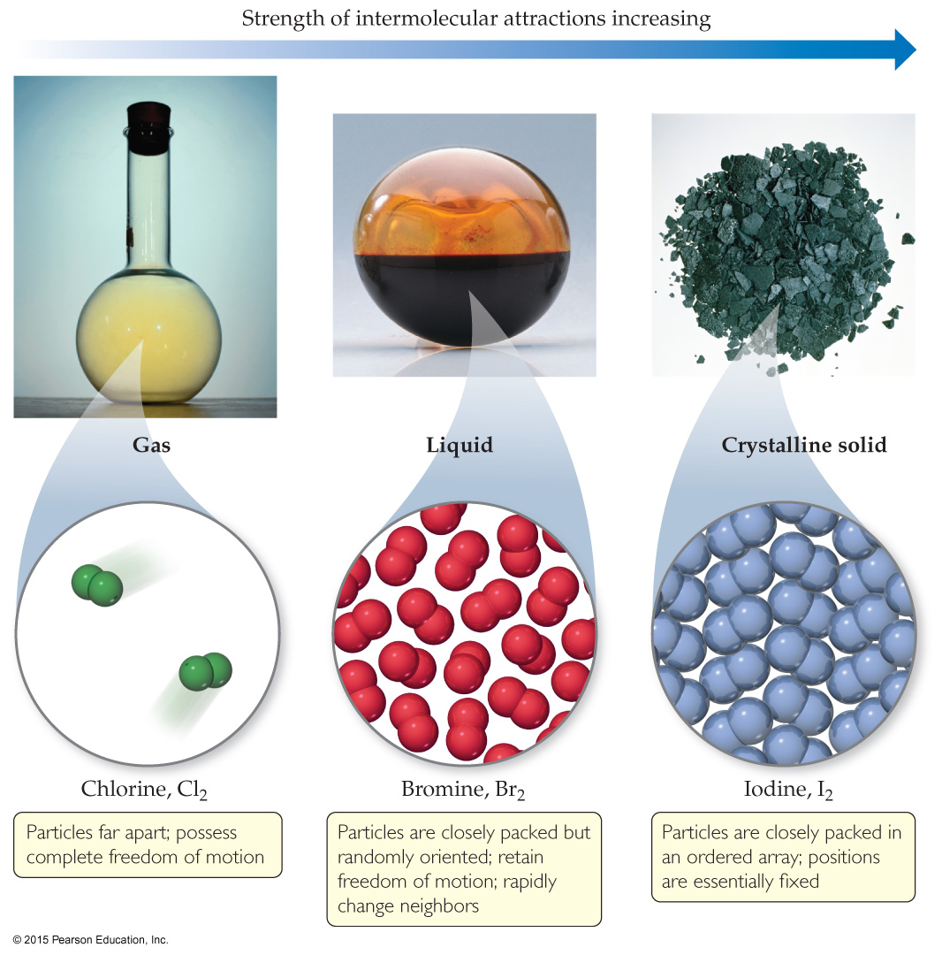
Intermolecular Forces
The strengths of intermolecular forces are generally weaker than either ionic or covalent bonds.
16 kJ/mol (to separate molecules)
δ⁺
δ⁻
δ⁺
δ⁻
431 kJ/mol (to break bond)

Slide 67
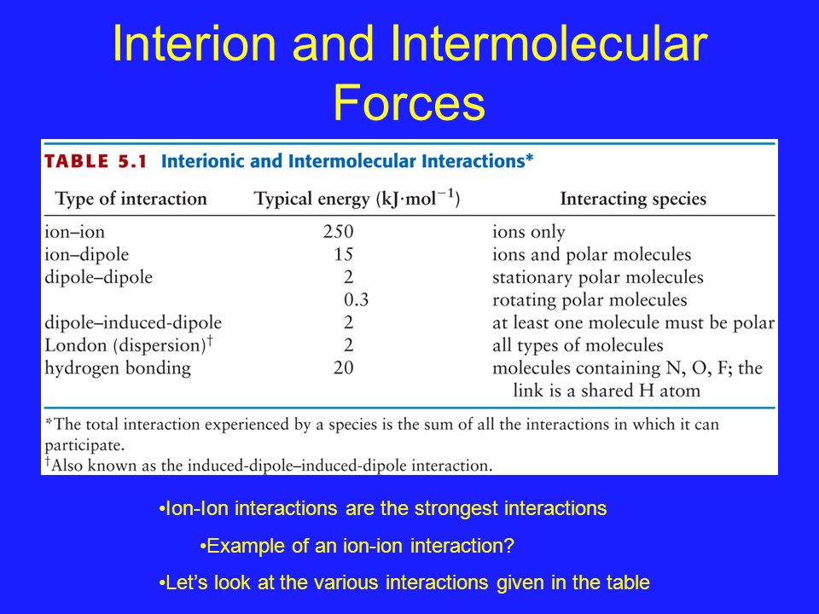

Slide 68
Major Types of Intermolecular Forces
Weakest to strongest forces:
dispersion forces (or London dispersion forces)
dipole–dipole forces
hydrogen bonding (a special dipole–dipole force)
ion–dipole forces
Note: The first two types are also referred to collectively as van der Waals forces.
Many physical properties reflect intermolecular forces, like boiling points, melting points, viscosity, surface tension, and capillary action.

Slide 69
Ion-ion Forces
Strongest of the intermolecular bonds.
Takes place between groups of opposite charge.
The strength of the ionic interaction is inversely proportional to the distance between the two charged groups.
Stronger interactions occur in hydrophobic environments.
Force depends on the charge on the ions and the distance separating the ions.

Slide 70
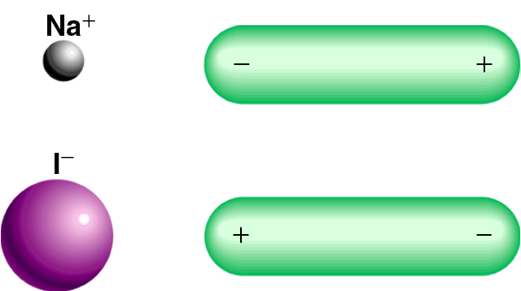
Intermolecular Forces
Ion-Dipole Forces
Attractive forces between an ion and a polar molecule
Example: ions in solution
Ion-Dipole Interaction

Slide 71
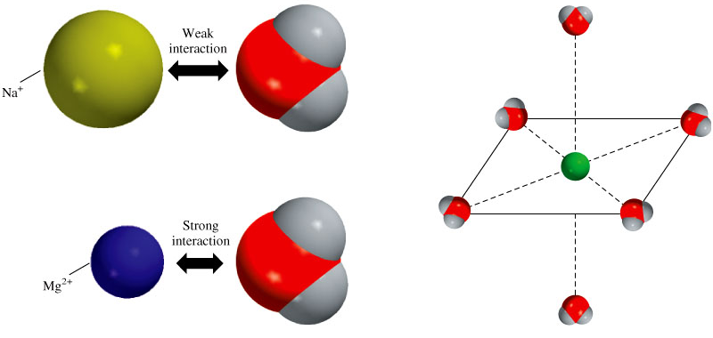
Ion-Dipole Forces
The strength of the interaction depends on the charge and size of the ion and on the magnitude of the dipole moment and size of the molecule.
Water molecules
Higher charge, smaller size→ strong interaction

Slide 72
Ion-Dipole Forces
Since atomic number of magnesium is more than that of sodium but the numbers of shells are same, the nuclear pull is more in case of Mg atom. Hence its size is smaller than sodium.
Magnesium has atomic number of 12 (2:8:2)
Sodium has atomic number of 11 (2:8:1)

Slide 73
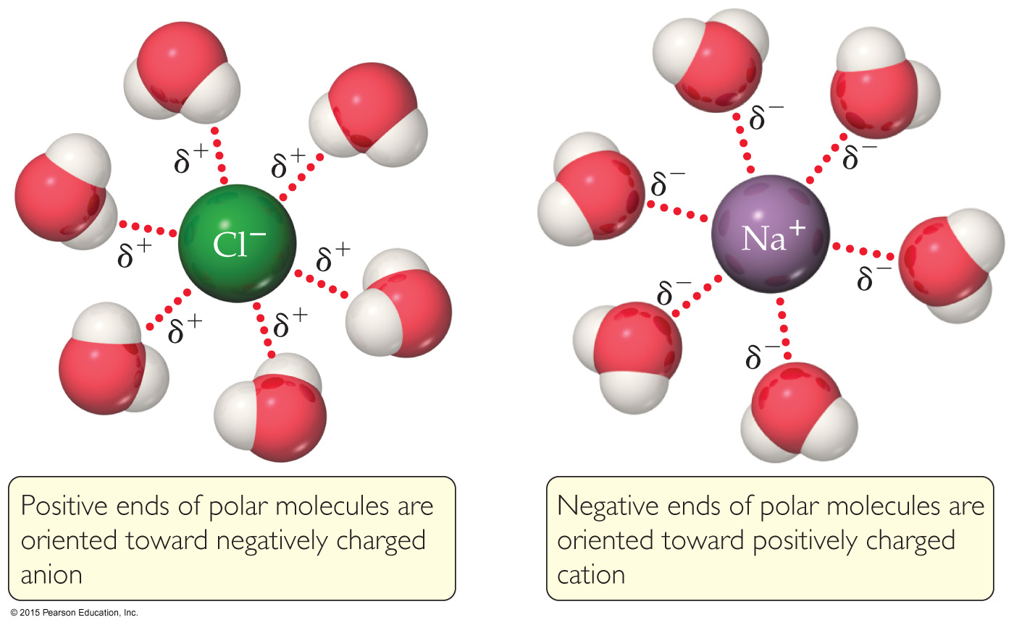
Ion–Dipole Interactions
Ion–dipole interactions are found in solutions of ions.
The strength of these forces is what makes it possible for ionic substances to dissolve in polar solvents.

Slide 74
Dipole – Dipole Forces
Dipole-dipole forces occur between molecules with permanent dipoles (i.e., polar molecules).
For molecules of similar sizes and masses, the strength of these forces increases with increasing polarity.

Slide 75
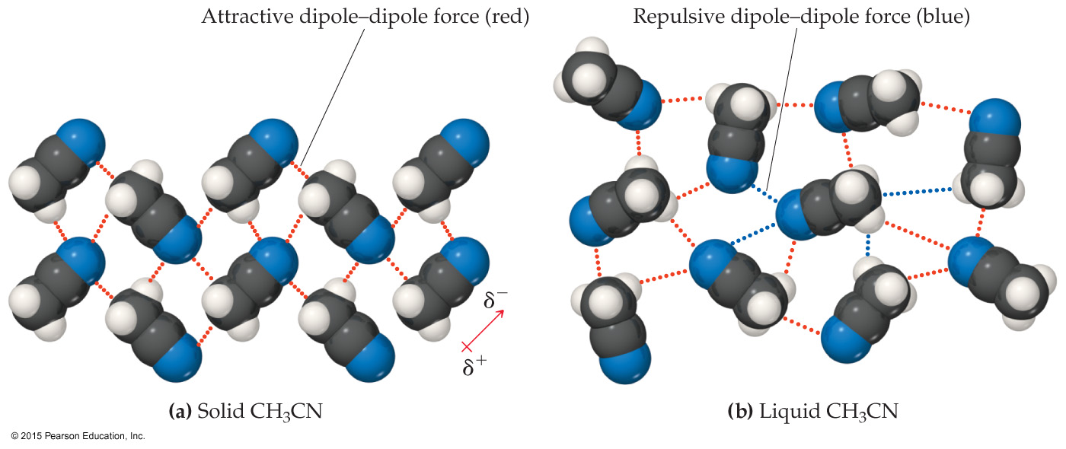
Dipole–Dipole Interactions
Polar molecules have a more positive and a more negative end–a dipole (two poles, δ⁺ and δ⁻).
The oppositely charged ends attract each other.

Slide 76
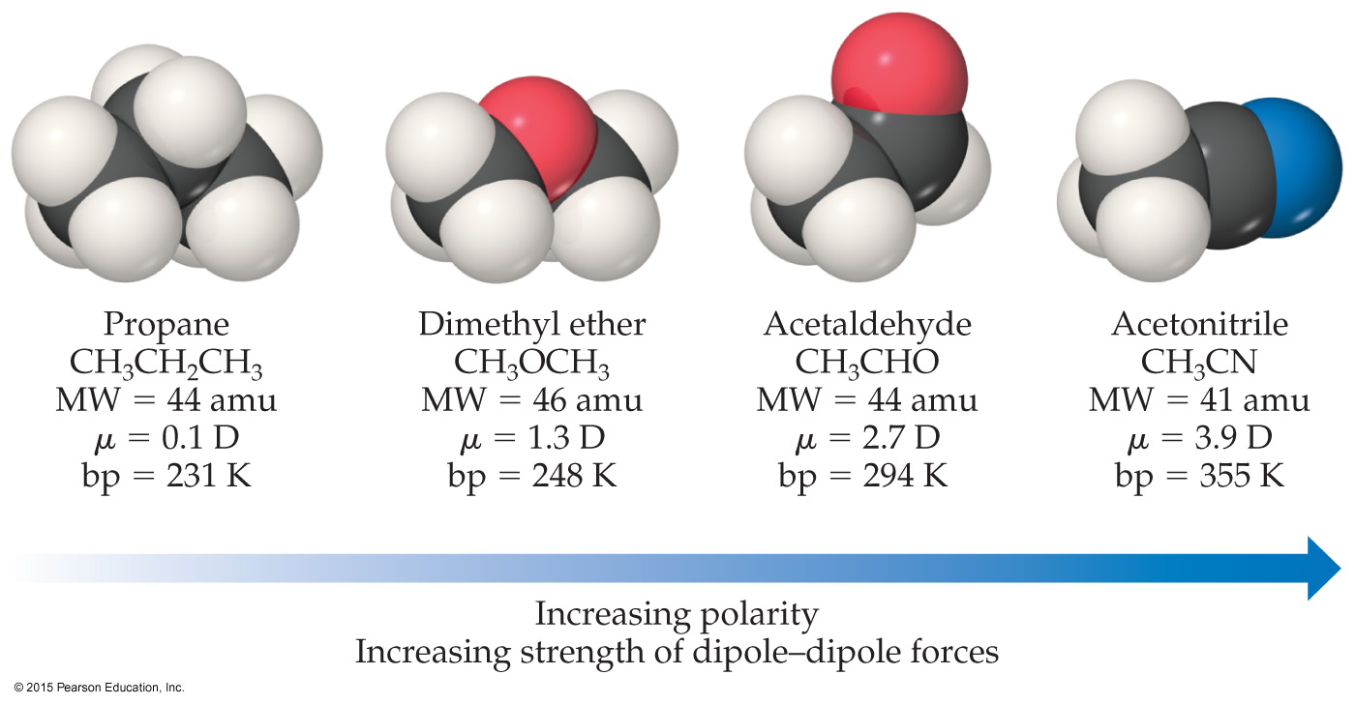
Dipole–Dipole Interactions
For molecules of approximately equal mass and size, the more polar the molecule, the higher its boiling point.

Slide 77
Which Have a Greater Effect: Dipole–Dipole Interactions or Dispersion Forces?
If two molecules are of comparable size and shape, dipole–dipole interactions will likely be the dominating force.
If one molecule is much larger than another, dispersion forces will likely determine its physical properties.

Slide 78
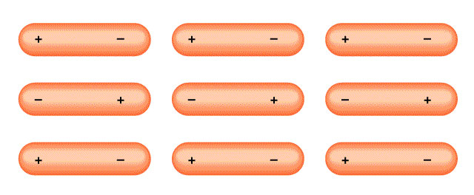
Intermolecular Forces
Dipole-Dipole Forces (permanent dipole moment)
Attractive forces between polar molecules
Orientation of Polar Molecules in a Solid

Slide 79
Types of intermolecular forces
Dipole-dipole forces: (polar molecules)
..
^{δ+}
S
..
:
dipole-dipole attraction
O
O
:
:
..
^{δ-}
^{δ-}
..
^{δ+}
S
..
:
:
O
O
:
..
^{δ-}
^{δ-}
What effect does this attraction have on the boiling point?

Slide 80
Polar molecules have
dipole-dipole attractions for
one another.
^{δ+}HCl^{δ-}---- ^{δ+}HCl^{δ-}
dipole-dipole attraction

Slide 81
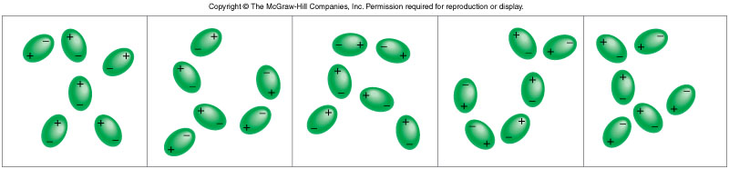
London Dispersion Force (Dispersion force)
If we place a molecule next to a polar molecule, the electric field of the dipole exerts a force on the electrons of the other molecule, resulting in an induced dipole.
The polarizability is a measure of how large an induced dipole is produced for a given electric field.
Polarizability allows gases containing atoms or nonpolar molecules (e.g.He, N₂) to condense. These forces are present in all molecules, whether they are polar or nonpolar.
At any instant it is likely that the atom has a dipole moment created by a specific positions of electrons. This dipole moment is called instantaneous dipole.
Induced dipoles interacting with each other. This type of interaction produces dispersion forces, which arise as a result of temporary dipoles induced in atoms or molecules, is responsible for the condensation of nonpolar gases.
**Dispersion force exists between all species.

Slide 82
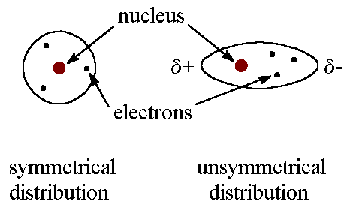
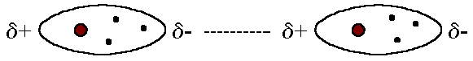
London Dispersion Forces
The London dispersion force is a temporary attractive force that results when the electrons in two adjacent atoms occupy positions that make the atoms form temporary dipoles.
Also called induced dipole-induced dipole attraction, they cause nonpolar substances to condense to liquids and to freeze into solids when the temperature is lowered sufficiently.
Owing to the constant motion of the electrons, an atom or molecule can develop a temporary (instantaneous) dipole when its electrons are distributed unsymmetrically about the nucleus.
A second atom or molecule, in turn, can be distorted by the appearance of the dipole in the first atom or molecule (because electrons repel one another) which leads to an electrostatic attraction between the two atoms or molecules.
Dispersion forces are present between any two molecules (even polar molecules) when they are almost touching.

Slide 83
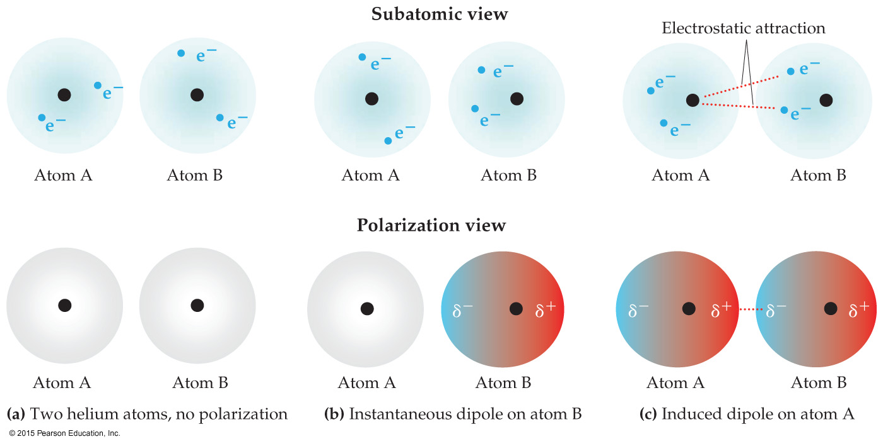
London Dispersion Forces
When a nonpolar particle (in this case a helium atom) is temporarily polarized to allow dispersion force to form.
The tendency of an electron cloud to distort in a way that it induces an instant dipole is called polarizability.
The more loosely held the electrons are, the larger the polarizability. =>> atomic polarizability increases as we move down a group.

Slide 84
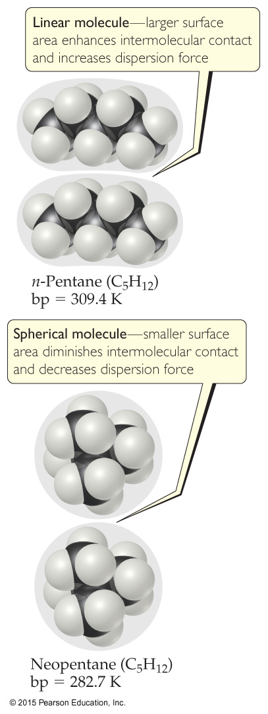
Factors Which Affect Amount of Dispersion Force in a Molecule
Number of electrons in an atom (more loosely held-electrons, more dispersion force)
Size of atom or molecule/molecular weight
Shape of molecules with similar masses (more compact, less dispersion force but more surface area more dispersion forces)
Pi-bonding (more pi-bonding, more dispersion force)

Slide 85
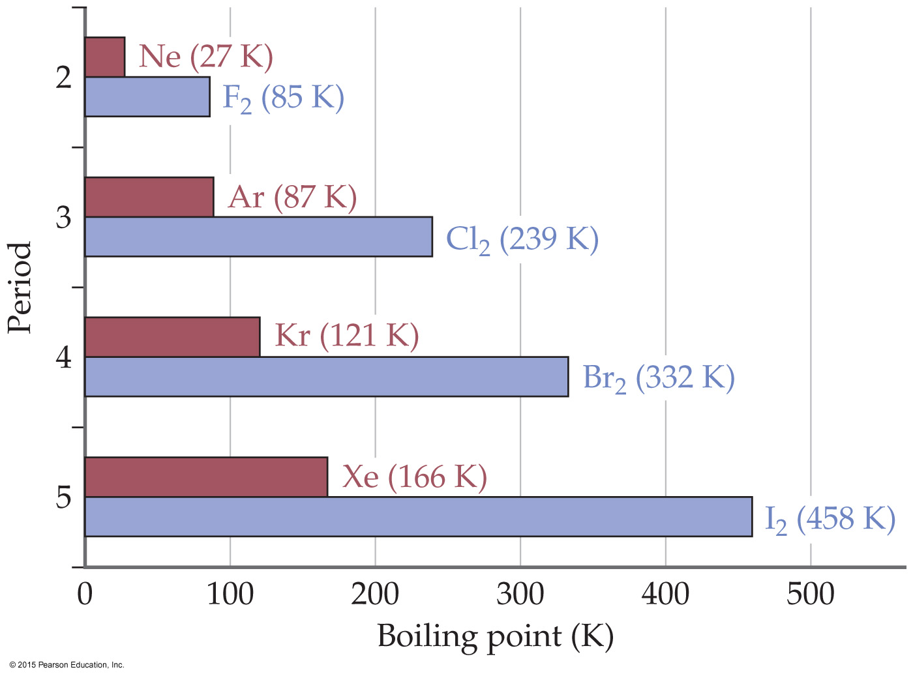
Polarizability & Boiling Point – The instantaneous dipole–induced dipole attractions are called London dispersion forces after Fritz London (1900–1954), a German physicist
Dispersion forces becomes stronger with increasing polarizability. Thus, molecules attract one another more strongly and melting and boiling points of covalent substances increase with larger molecular mass. i.e. If something is harder to polarize, it has a lower boiling point.
Remember: This means less intermolecular force (smaller molecule: lower molecular weight, fewer electrons).
Polarizability also affects dispersion forces through the molecular shape of the affected molecules. Elongated molecules have electrons that are easily moved increasing their polarizability and thus strengthening the dispersion forces.
In contrast, small, compact, symmetrical molecules are less polarizable resulting in weaker dispersion forces.

Slide 86
Hydrogen Bonding
Hydrogen bonding is the attraction between a hydrogen atom of a molecule to an unshared pair of electrons in another molecule.
Hydrogen bonding occurs in molecules where hydrogen is covalently bonded to a very electronegative element.
Hydrogen bonding occurs in molecules containing
F, 0 and N.

Slide 87
Hydrogen Bonding
Hydrogen bonds are the strongest of all intermolecular forces.
Hydrogen bonds are possible because in hydrogen atoms there is no shielding of the nucleus.
Hydrogen bonds are responsible for the physical properties of many biological substances and, more importantly, water.

Slide 88
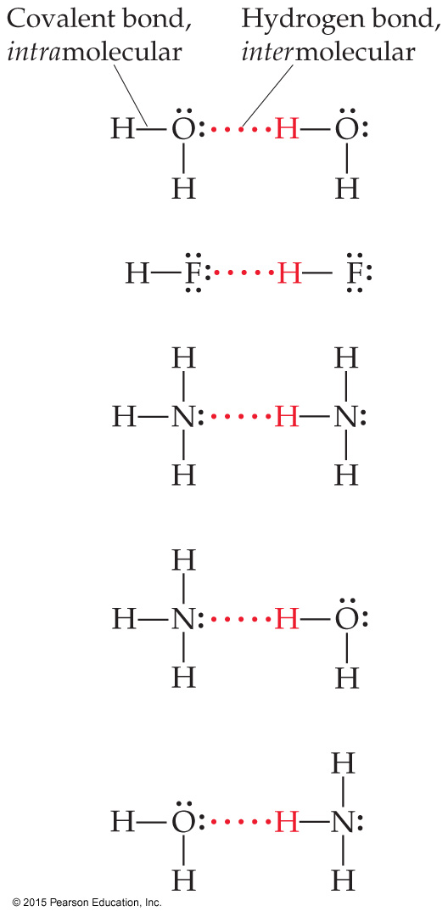
Hydrogen Bonding
The dipole–dipole interactions experienced when H is bonded to N, O, or F are unusually strong.
We call these interactions hydrogen bonds.
A hydrogen bond is an attraction between a hydrogen atom attached to a highly electronegative atom and a nearby small electronegative atom in another molecule or chemical group.

Slide 89
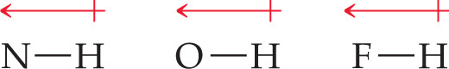
What Forms Hydrogen Bonds?
Hydrogen bonding arises in part from the high electronegativity of nitrogen, oxygen, and fluorine.
These atoms interact with a nearly bare nucleus (which contains one proton).

Slide 90

Hydrogen Bonding
Hydrogen bonding: cases of very strong dipole-dipole interaction (bonds involving H-F, H-O, and H-N are most important cases).
^{δ+}H-F^{δ-} --- ^{δ+}H-F^{δ-}
Hydrogen bonding

Slide 91
Question
What type(s) of intermolecular forces exist between each of the following molecules?
HBr, CH₄ and SO₂

Slide 92
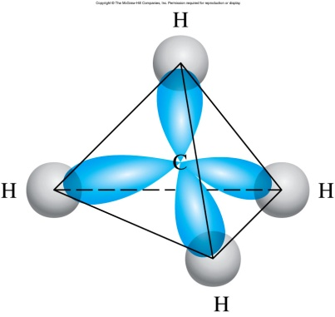
Answers
HBr
HBr is a polar molecule: dipole-dipole forces. There are also dispersion forces between HBr molecules.
CH₄
CH₄ is nonpolar: dispersion forces.
S
O
O
SO₂
SO₂ is a polar molecule: dipole-dipole forces. There are also dispersion forces between SO₂ molecules.

Slide 93
Note
Dipole: A polar molecule that has two poles.
Van der Waals/Dispersion Forces
–Caused by the motion of electrons.
–Increase as the number of electrons increases.
-Weakest of all intermolecular forces.

Slide 94
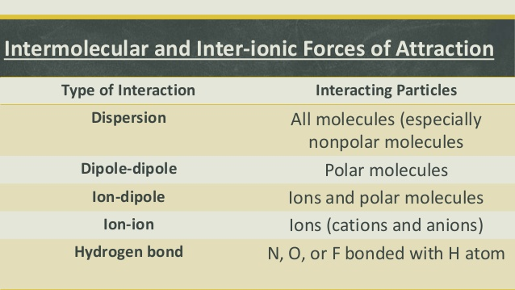
Liquids

Slide 95
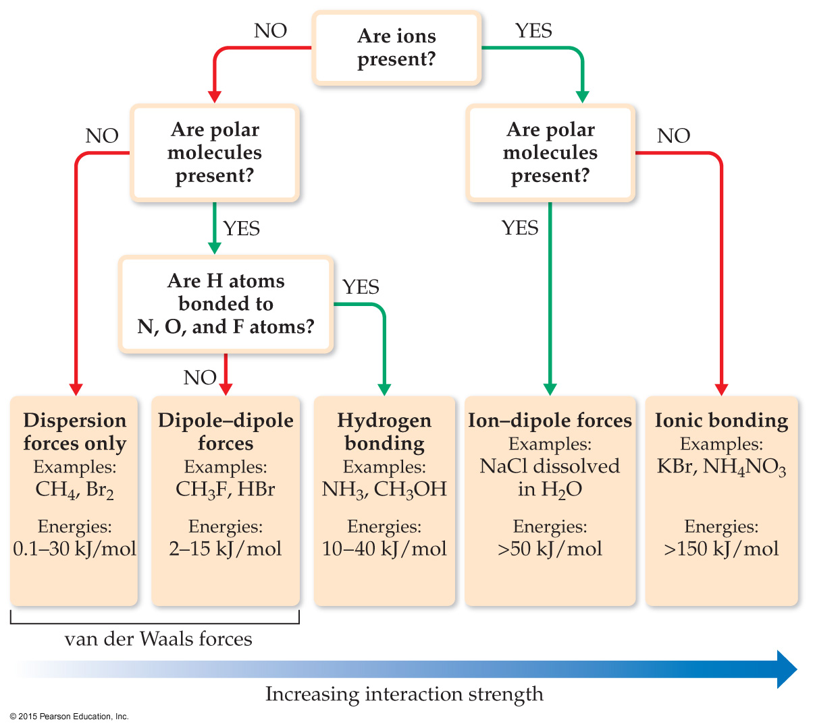
Summarizing Intermolecular Forces

